Slide 1
UNIT-4
Introduction of Data Link Layer

Slide 2



INTRODUCTION
Host and routers are as nodes.
Communication channels that connect adjacent nodes along communication path, its called links.
Wired links
Wireless links
LANs
In this layer, Packet is form of frame from encapsulate datagram.
This layer has responsibility of transferring datagram from one node to physically adjacent node over a link.

Slide 3
Link Layer Services
Framing
Encapsulate datagram into frame.
Adding header and trailer.
Link Access
“MAC” addresses used in frame headers to identify source and destination. It is different from IP address.
Reliable Delivery
If this layer protocol provides reliable delivery service, it guarantees to move each network-layer datagram across the link without error.
A link-layer reliable delivery service can be achieved with acknowledgments and retransmissions.
Flow Control
Pacing between adjacent sending and receiving nodes.
Error Detection & Correction
Errors caused by signal attenuation and noise.
Receiver detects presence of errors.
Sender send signal for retransmission or drops frame.
Receiver identifies and corrects bit error(s) without resorting to retransmission.

Slide 4
Error Detection in Computer Networks
Error is a condition when the receiver’s information does not match the sender’s information. During transmission, digital signals suffer from noise that can introduce errors in the binary bits traveling from sender to receiver. That means a 0 bit may change to 1 or a 1 bit may change to 0.
Types of Errors
Single-Bit Error
A single-bit error refers to a type of data transmission error that occurs when one bit (i.e., a single binary digit) of a transmitted data unit is altered during transmission, resulting in an incorrect or corrupted data unit.

Slide 5
Error Detection in Computer Networks
Multiple-Bit Error
A multiple-bit error is an error type that arises when more than one bit in a data transmission is affected. Although multiple-bit errors are relatively rare when compared to single-bit errors, they can still occur, particularly in high-noise or high-interference digital environments.
1.Parity Check
2.Checksum
3.Cyclic Redundancy Check (CRC)

Slide 6
Parity Check
Simple-bit parity is a simple error detection method that involves adding an extra bit to a data transmission. It works as:
1 is added to the block if it contains an odd number of 1’s, and
0 is added if it contains an even number of 1’s
Disadvantages
Single Parity check is not able to detect even no. of bit error.
For example, the Data to be transmitted is 101010. Codeword transmitted to the receiver is 1010101 (we have used even parity). Let’s assume that during transmission, two of the bits of code word flipped to 1111101. On receiving the code word, the receiver finds the no. of ones to be even and hence no error, which is a wrong assumption.

Slide 7
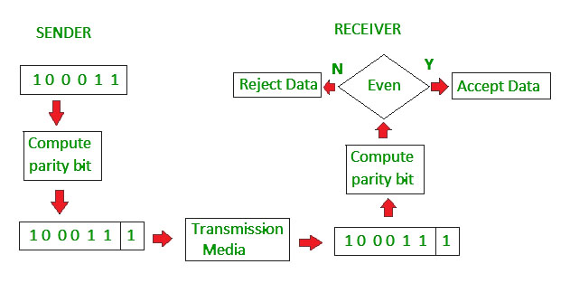
Parity Check

Slide 8
Checksum
Checksum error detection is a method used to identify errors in transmitted data. The process involves dividing the data into equally sized segments and using a 1’s complement to calculate the sum of these segments. The calculated sum is then sent along with the data to the receiver. At the receiver’s end, the same process is repeated and if all zeroes are obtained in the sum, it means that the data is correct.
Checksum – Operation at Sender’s Side
Firstly, the data is divided into k segments each of m bits.
On the sender’s end, the segments are added using 1’s complement arithmetic to get the sum. The sum is complemented to get the checksum.
The checksum segment is sent along with the data segments.
Checksum – Operation at Receiver’s Side
At the receiver’s end, all received segments are added using 1’s complement arithmetic to get the sum. The sum is complemented.
If the result is zero, the received data is accepted; otherwise discarded.

Slide 9
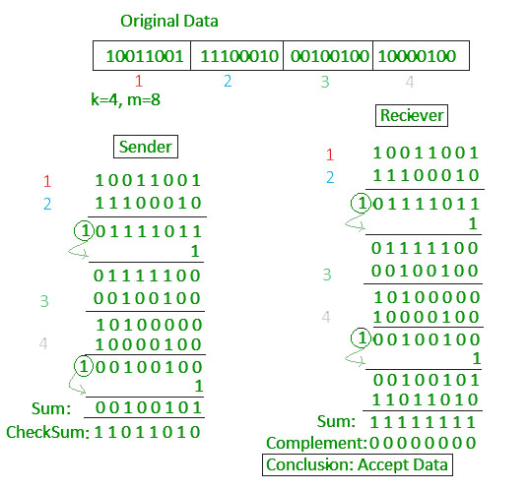
Checksum

Slide 10
Cyclic Redundancy Check (CRC)
Unlike the checksum scheme, which is based on addition, CRC is based on binary division.
In CRC, a sequence of redundant bits, called cyclic redundancy check bits, are appended to the end of the data unit so that the resulting data unit becomes exactly divisible by a second, predetermined binary number.
At the destination, the incoming data unit is divided by the same number. If at this step there is no remainder, the data unit is assumed to be correct and is therefore accepted.
A remainder indicates that the data unit has been damaged in transit and therefore must be rejected.

Slide 11
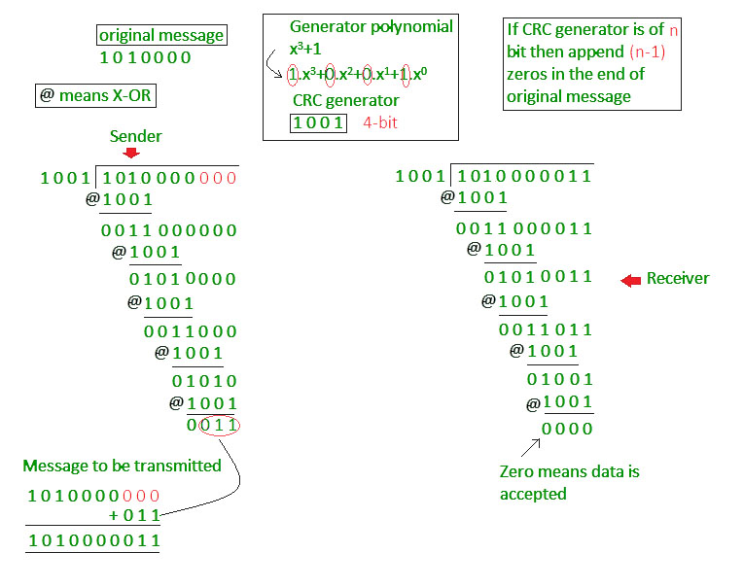
Cyclic Redundancy Check (CRC)

Slide 12
FRAMING
In computer networks, the data is transferred from one device to another user using various technologies and protocols. The data has to go through many layers and each layer performs its own function on the data one of the functions is converting the data into frames. The data can be intercepted by unwanted individuals which will lead to security risks and issues. There are various mechanisms that we use to protect the data in computer networks one of them being framing.
A frame typically includes a series of symbols or bits that provide frame synchronization advantages. In the bits and symbols sequence it gets, it displays the beginning and end of the payload data. at the moment a frame is broadcast when a receiver is connected to the system. Until it discovers a new frame coordination sequence, it stays away from the information.

Slide 13

FRAMING
Parts of Frame
A frame generally has the following parts:
Frame Header: It contains the source and destination address of the frame.
Payload Field: It will contain the message which is needed to be delivered.
Trailer: It contains the error correction and error detection bits.
Flag: It marks the beginning and the end of the frame.

Slide 14
Types of framing
There are two types of framing: 1. Fixed-size: The frame is of fixed size and there is no need to provide boundaries to the frame, the length of the frame itself acts as a delimiter.
Drawback: It suffers from internal fragmentation if the data size is less than the frame size
Solution: Padding
2. Variable size: In this, there is a need to define the end of the frame as well as the beginning of the next frame to distinguish. This can be done in two ways:
Length field – We can introduce a length field in the frame to indicate the length of the frame. Used in Ethernet(802.3). The problem with this is that sometimes the length field might get corrupted.
End Delimiter (ED) – We can introduce an ED(pattern) to indicate the end of the frame. Used in Token Ring. The problem with this is that ED can occur in the data.

Slide 15
Approaches of Framing
Bit Stuffing
n a bit-oriented protocol, the data to send is a series of bits.
In order to distinguish frames, most protocols use a bit pattern of 8-bit length (01111110) as flag at the beginning and end of each frame.
Here also cause the problem of appearance of flag in the data part to deal with this an extra bit added.
This method is called bit stuffing.
If a 0 and five successive 1 bits are encountered, an extra 0 is added.
The receiver node removes the extra-added zero.

Slide 16
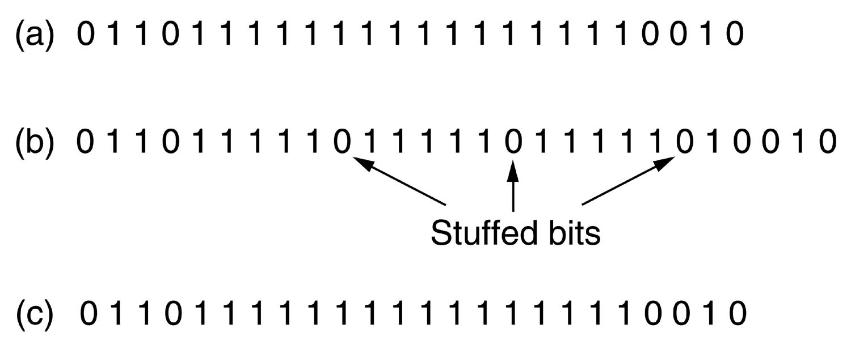
Bit Stuffing

Slide 17
Byte Stuffing
Problem of resynchronization by having each frame start and end with special bytes.
A flag byte is used to separate the frame as both the starting and ending delimiter.
This technique is called byte stuffing or character stuffing.
In this way, if the receiver ever loses synchronization, it can just search for the flag byte to find the end of the current frame.
Two consecutive flag bytes indicate the end of one frame and start of the next one.
To solve this problem, is to have the sender's data link layer insert a special escape byte (ESC) just before each "accidental" flag byte in the data.
The data link layer on the receiving end removes the escape byte before the data are given to the network layer.

Slide 18
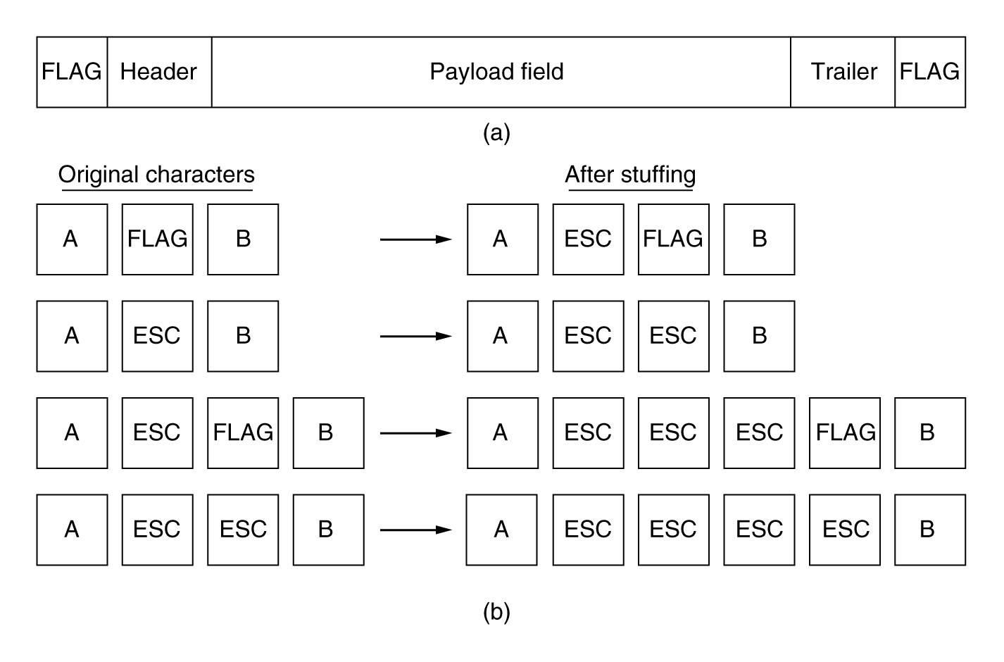
Byte Stuffing

Slide 19
Flow Control in Data Link Layer
Flow control is design issue at Data Link Layer. It is a technique that generally observes the proper flow of data from sender to receiver. It is very essential because it is possible for sender to transmit data or information at very fast rate and hence receiver can receive this information and process it.
Flow control is actually set of procedures that explains sender about how much data or frames it can transfer or transmit before data overwhelms receiver. The receiving device also contains only limited amount of speed and memory to store data. This is why receiving device should be able to tell or inform the sender about stopping the transmission or transferring of data on temporary basis before it reaches limit. It also needs buffer, large block of memory for just storing data or frames until they are processed.

Slide 20
Flow Control in Data Link Layer
Approaches to Flow Control : Flow Control is classified into two categories:
Feedback – based Flow Control : In this control technique, sender simply transmits data or information or frame to receiver, then receiver transmits data back to sender and also allows sender to transmit more amount of data or tell sender about how receiver is processing or doing. This simply means that sender transmits data or frames after it has received acknowledgements from user.
Rate – based Flow Control : In this control technique, usually when sender sends or transfer data at faster speed to receiver and receiver is not being able to receive data at the speed, then mechanism known as built-in mechanism in protocol will just limit or restricts overall rate at which data or information is being transferred or transmitted by sender without any feedback or acknowledgement from receiver.

Slide 21
Stop and Wait Protocol
Techniques of Flow Control in Data Link Layer : There are basically two types of techniques being developed to control the flow of data
This method is the easiest and simplest form of flow control. In this method, basically message or data is broken down into various multiple frames, and then receiver indicates its readiness to receive frame of data. When acknowledgement is received, then only sender will send or transfer the next frame. This process is continued until sender transmits EOT (End of Transmission) frame. In this method, only one of frames can be in transmission at a time. It leads to inefficiency i.e. less productivity if propagation delay is very much longer than the transmission delay and Ultimately In this method sender sent single frame and receiver take one frame at a time and sent acknowledgement(which is next frame number only) for new frame.
Advantages –
This method is very easiest and simple and each of the frames is checked and acknowledged well.
This method is also very accurate.
Disadvantages –
This method is fairly slow.
In this, only one packet or frame can be sent at a time.
It is very inefficient and makes the transmission process very slow.

Slide 22
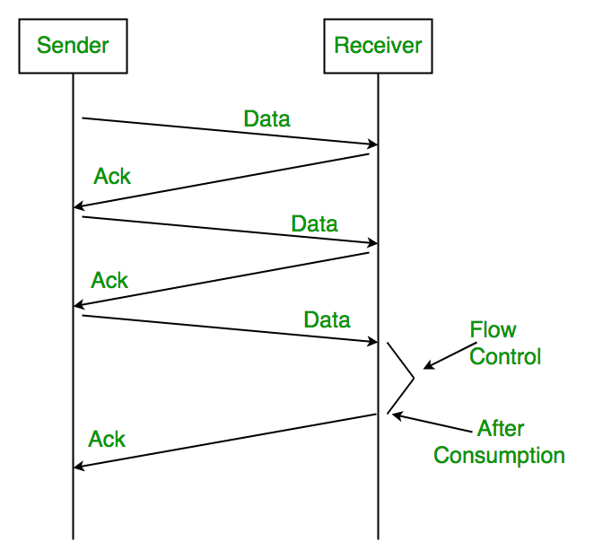
Stop and Wait Protocol

Slide 23
Sliding Window Protocol
The sliding window is a technique for sending multiple frames at a time. It controls the data packets between the two devices where reliable and gradual delivery of data frames is needed. It is also used in TCP (Transmission Control Protocol).
In this technique, each frame has sent from the sequence number. The sequence numbers are used to find the missing data in the receiver end. The purpose of the sliding window technique is to avoid duplicate data, so it uses the sequence number.
Go-Back-N ARQ
Go-Back-N ARQ protocol is also known as Go-Back-N Automatic Repeat Request. It is a data link layer protocol that uses a sliding window method. In this, if any frame is corrupted or lost, all subsequent frames have to be sent again.
The size of the sender window is N in this protocol. For example, Go-Back-8, the size of the sender window, will be 8. The receiver window size is always 1.
If the receiver receives a corrupted frame, it cancels it. The receiver does not accept a corrupted frame. When the timer expires, the sender sends the correct frame again.

Slide 24
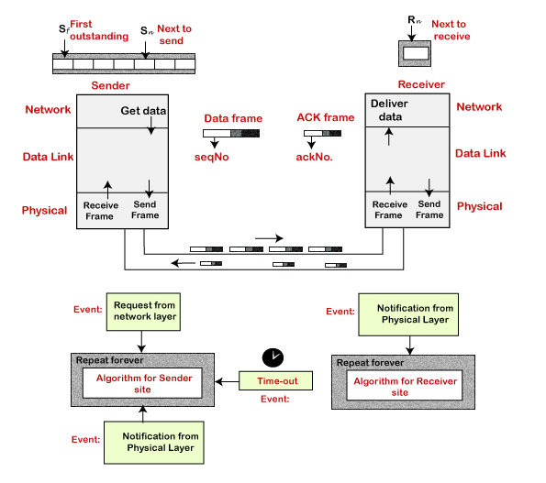
Sliding Window Protocol

Slide 25
Internet Protocol
Here, IP stands for internet protocol. It is a protocol defined in the TCP/IP model used for sending the packets from source to destination. The main task of IP is to deliver the packets from source to the destination based on the IP addresses available in the packet headers. IP defines the packet structure that hides the data which is to be delivered as well as the addressing method that labels the datagram with a source and destination information.
An IP protocol provides the connectionless service, which is accompanied by two transport protocols, i.e., TCP/IP and UDP/IP, so internet protocol is also known as TCP/IP or UDP/IP.
The first version of IP (Internet Protocol) was IPv4. After IPv4, IPv6 came into the market, which has been increasingly used on the public internet since 2006.

Slide 26
History of Internet Protocol
The development of the protocol gets started in 1974 by Bob Kahn and Vint Cerf. It is used in conjunction with the Transmission Control Protocol (TCP), so they together named the TCP/IP.
The first major version of the internet protocol was IPv4, which was version 4. This protocol was officially declared in RFC 791 by the Internet Engineering Task Force (IETF) in 1981.
After IPv4, the second major version of the internet protocol was IPv6, which was version 6. It was officially declared by the IETF in 1998. The main reason behind the development of IPv6 was to replace IPv4. There is a big difference between IPv4 and IPv6 is that IPv4 uses 32 bits for addressing, while IPv6 uses 128 bits for addressing.

Slide 27
Function of Internet protocol
The main function of the internet protocol is to provide addressing to the hosts, encapsulating the data into a packet structure, and routing the data from source to the destination across one or more IP networks. In order to achieve these functionalities, internet protocol provides two major things which are given below.
An internet protocol defines two things:
Format of IP packet
IP Addressing system

Slide 28
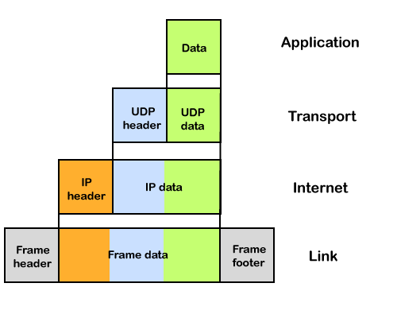
What is an IP packet?
Before an IP packet is sent over the network, two major components are added in an IP packet, i.e., header and a payload.

Slide 29
What is an IP packet?
Source IP address: The source is the one who is sending the data.
Destination IP address: The destination is a host that receives the data from the sender.
Header length
Packet length
TTL (Time to Live): The number of hops occurs before the packet gets discarded.
Transport protocol: The transport protocol used by the internet protocol, either it can be TCP or UDP.
There is a total of 14 fields exist in the IP header, and one of them is optional.
Payload: Payload is the data that is to be transported.

Slide 30
How does the IP routing perform?
IP routing is a process of determining the path for data so that it can travel from the source to the destination. As we know that the data is divided into multiple packets, and each packet will pass through a web of the router until it reaches the final destination. The path that the data packet follows is determined by the routing algorithm. The routing algorithm considers various factors like the size of the packet and its header to determine the efficient route for the data from the source to the destination. When the data packet reaches some router, then the source address and destination address are used with a routing table to determine the next hop's address. This process goes on until it reaches the destination. The data is divided into multiple packets so all the packets will travel individually to reach the destination.

Slide 31
What is IP Addressing?
IPv4 addresses are divided into two categories:
Public address
The public address is also known as an external address as they are grouped under the WAN addresses. We can also define the public address as a way to communicate outside the network. This address is used to access the internet. The public address available on our computer provides the remote access to our computer. With the help of a public address, we can set up the home server to access the internet. This address is generally assigned by the ISP (Internet Service Provider).
Key points related to public address are:
The scope of the public address is global, which means that we can communicate outside the network.
This address is assigned by the ISP (Internet Service Provider).
It is not available at free of cost.
We can get the Public IP by typing on Google "What is my IP".

Slide 32
Private address
A private address is also known as an internal address, as it is grouped under the LAN addresses. It is used to communicate within the network. These addresses are not routed on the internet so that no traffic can come from the internet to this private address. The address space for the private address is allocated using InterNIC to create our own network. The private addresses are assigned to mainly those computers, printers, smartphones, which are kept inside the home or the computers that are kept within the organization. For example, a private address is assigned to the printer, which is kept inside our home, so that our family member can take out the print from the printer.
If the computer is assigned with a private address, then the devices available within the local network can view the computer through the private ip address. However, the devices available outside the local network cannot view the computer through the private IP address, but they can access the computer if they know the router's public address. To access the computer directly, NAT (Network Address Translator) is to be used.
Key points related to private address are:
Its scope is local, as we can communicate within the network only.
It is generally used for creating a local area network.
It is available at free of cost.
We can get to know the private IP address by simply typing the "ipconfig" on the command prompt.

